Slide 1

RETAIL BANKING TRANSACTION
ANALYSIS
SQL Project
Presented By –M.shivacharan
(2025 -2026)
In
Computer Science & Data Science

Slide 2
About me
Hello everyone, my name is Shivacharan. I completed my B.Tech and I am a fresher. I am interested in Data Science and
currently learning Python, SQL, Pandas, NumPy, and Data Analysis. I want to improve my technical skills and build a
successful career in the Data Science field. I am passionate about learning new technologies and working on real-world
projects.
Share your LinkedIn and GitHub profile URLs
Why you want to learn Data Science
https://www.linkedin.com/in/shivacharan-mandala
I want to learn Data Science because I enjoy working with data.
It helps solve real-world problems using insights and technology.
I want to improve my skills in Python, SQL, and Machine Learning.
My goal is to build a successful career in the Data Science field.
https://github.com/shivacharan30

Slide 3
TABLE OF CONTENTS
Introduction
Project Overview
Business Scenario
Business Objectives
Dataset & Database Overview
ER Diagram /Database Structure
Analysis of the Objectives
  Overall keys Findings
Business Recommendations
Conclusion
Q&A

Slide 4
INTRODUCTION
Retail Banking generates large volume of transaction data every day .
Retail Bank Transaction Analysis focuses on analyzing customer banking transactions to understand spending,patterns,transactions behaviour and financial trends.
This project mainly uses SQL and data analytics techniques to examine deposits,withdrawls,transfers,transaction volumes and customer activity.
It helps identify high- value customers, unusual transactions,popular transactions.
Customer profiles and segmentation
Account usage and balances
Banking transactions
Branch performance
Loan portfolio and repayment behavior
Card usage and Customer banking-product adoption

Slide 5
PROJECT OVERVIEW
The project Uses Retail Banking SQL Business Analytics is a MySQL-based data analytics project designed to analyze customer, account, transaction, loan, and card-related data of a retail bank.
The analysis covers five major business areas:
Customer Profile & Segmentation
Account Usage & Branch Activity
Transaction Patterns
Loan Performance & Repayment Behaviour
Card Usage & Product Engagement
Key Insight :
The project follows a structured process of database creation from the ER diagram, data import and verification, SQL-based analysis, business-question formulation, findings, insights, and recommendations

Slide 6
Business Scenario
A retail bank wants to analyze its customer and financial data to understand customer profiles, account usage, transaction behavior, loan performance, and card engagement.
The bank wants to use these insights to improve customer service, manage financial products, and support better business decisions.
This analysis can help the bank design personalized offers, improve customer retention, and increase cross-selling of banking products.
The bank wants to identify customers who have multiple products, such as accounts, cards, and loans, to improve cross-selling opportunities and increase customer value.
The bank can identify customers with low product usage and create targeted offers to encourage them to adopt additional banking services.

Slide 7
Business Objectives
Customer Analysis
Analyze customer segments
Compare income and credit scores
Identify active and inactive customers
Analyze KYC status
Account & Branch Analysis
Analyze different account types
Compare account balances
Analyze branch activity
Compare interest rates
Transaction Analysis
Identify common transaction types
Analyze transaction amounts
Identify popular transaction channels
Find high-activity accounts
Loan Analysis
Analyze loan types and purposes
Compare loan amounts
Analyze outstanding balances
Study loan repayment behavior
Card Analysis
Analyze card types
Compare active and inactive cards
Analyze credit limits
Analyze outstanding balances and reward points

Slide 8
DATASET & DATABASE OVERVIEW
Database : retail_banking analysis
Dataset Overview
The Dataset contains:
500 Customers – Bank customers their demography, financial and bank details.
700 Bank Accounts - Stores information about customer bank accounts
50 Branches - Stores information about different bank branches.
300 Loans – Stores information about loans taken by customers
600 Cards – Information about banking cards
5000 Transactions – Banking activities performed by customers
Database Overview :
These are main tables :
Customers
Accounts
Branches
Loans
Loan Payments
Cards
Transactions

Slide 9
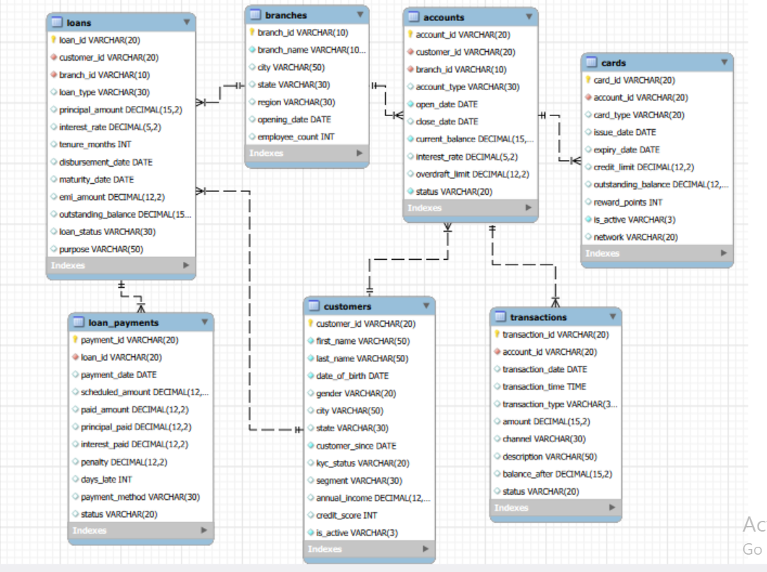
ER DIAGRAM & Database Structure
Key Relationships
Customers → Accounts
Branches → Accounts
Branches → Loans
Customers → Loans
Loans → Loan Payments
Accounts → Cards
Accounts → Transactions
Key Insight :
The ER model integrates customer, account, transaction, card, loan, branch, and repayment data relationships, enabling comprehensive analysis of customer behaviour and banking product engagement

Slide 10
Analysis of the Objectives
The project analyzed:
Customer segmentation
Customer locations
Average annual income
Average credit score
Active/inactive customers
Account balances
Account types
Branch activity
Transaction patterns
Loan performance
Loan repayment methods
Card usage and engagement

Slide 11
  Overall keys Findings
Customer segmentation helps understand different customer groups and their financial profiles.
Account analysis identifies account types, balances, and branch performance.
Transaction analysis shows the most frequently used transaction types and channels.
Loan analysis helps identify outstanding balances, loan status, and repayment patterns.
Card analysis provides insights into card usage, credit limits, and outstanding balances.
Active and inactive customers can be compared to understand overall customer engagement.
Different loan purposes and loan types reveal the major areas where customers require financing.
Card activity and reward points help measure customer engagement with banking products.
Transaction amounts and frequencies help identify high-value accounts and customer spending patterns.
Overall analysis helps the bank identify growth opportunities, manage risks, and improve customer services.

Slide 12
Bussiness Recommendation
Understand customers better – Use customer data to offer suitable products.
Increase product usage – Encourage customers to use more banking products like cards, loans, and
accounts.
Monitor transactions – Track transaction activity to identify important changes and patterns.
Improve loan repayment – Monitor late payments and penalties to reduce loan repayment problems.
Improve customer service – Use data insights to provide better services and make better business decisions.
The Overall recommendation bank should use customer and transaction data to improve services, increase product usage, and better understand customer needs. It should also monitor loan repayments and financial activity to reduce risks and make better business decisions.

Slide 13
Conclusion
This project helped the bank understand its customers, accounts, branches, transactions, loans, and cards using SQL analysis.
Customers: The bank can better understand customer segments, income, credit scores, and activity.
Accounts: Account balances, account types, and usage can be compared to understand customer banking needs.
Branches: Branch activity and account balances can be compared to identify strong and weak-performing branches.
Loans: Loan amounts, outstanding balances, repayment delays, and penalties can be monitored to improve loan performance.
Overall: The analysis helps the bank understand customer behaviour, reduce financial risks, improve services, and make better business decisions.

Slide 14

THANK YOU

